Slide 1


Slide 2



Safe from Harm
SAFE FROM HARM

Slide 3

Do you know what is …
health
adults
safe environment
openness
neglect
psychological
self-development
safeguarding
harmful
bullying
physical
risk planning
code of conduct
maltreatment
harm
emotional
victim
Whistle-blowing
children
support
ear
respect
abuse
legal framework
suffering
special needs
internet
practice
home
exposure
listening
exploitation
online safety
co-education
prevention
damage
relationship
sexual abuse
young people
parents
misuse
courage
violence
safety
protect
integrity
diversity
wellbeing
street
data protection
school

Slide 4

World Safe from harm Policy
The World Safe from Harm policy sets minimum level of implementation and could be used as an evaluation criteria when reviewing NSOs’ current policies and procedures.
www.scout.org/safe-from-harm-policy
Notes:
Available in five WOSM Working languages

Slide 5
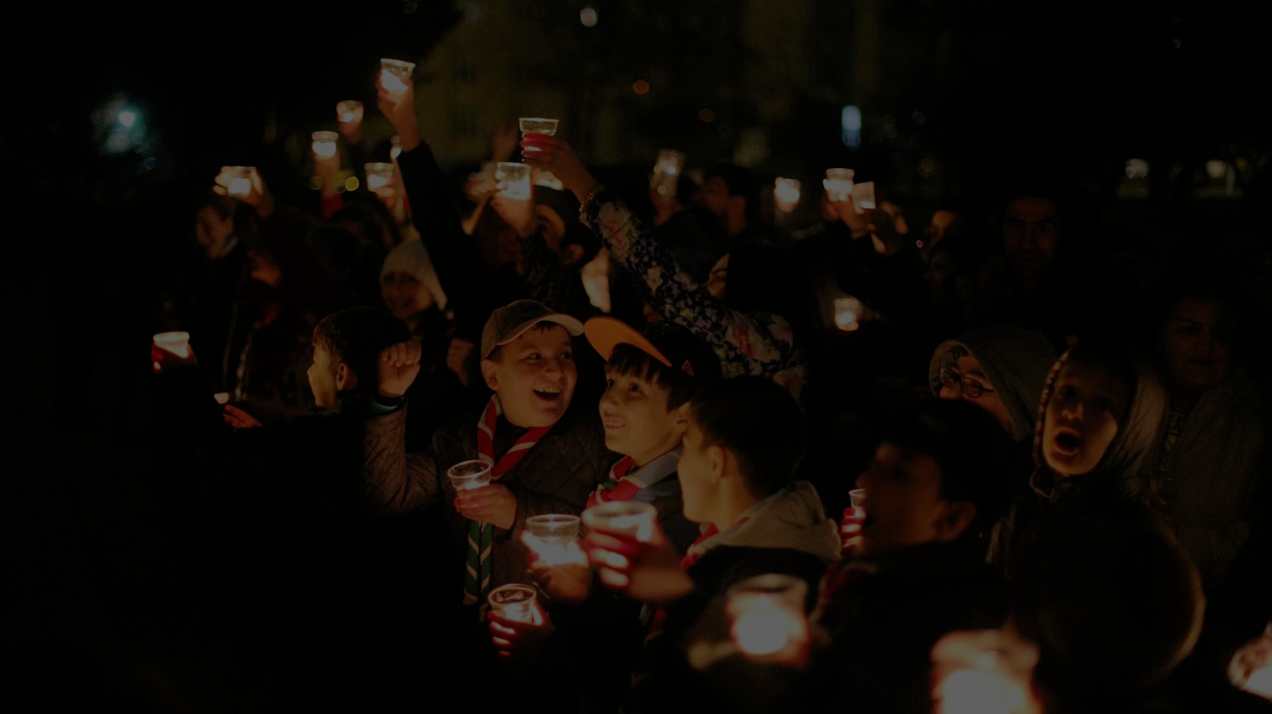
Safe environment for the development of children and young people
Everyone at all levels of World Scouting need to work together to provide children and young people with a safe environment in which they are empowered to develop their full potential.

Slide 6

Safe from Harm …
… encompasses all areas of child and youth protection work, and includes a full range of strategies, systems and procedures that aim to promote that the wellbeing, development and safety of children and young people is a priority in all Scouting-related activities.

Slide 7

Providing a safe environment encompasses …
Educational purpose of Scouting activities,
Safety in Scouting activities,
Development of personal skills,
Involving all stakeholders (e.g. children and young people, adult volunteers and professional staff, parents, school authorities, faith-based organisations),
Creating and awareness, promoting and encouraging positive behaviour.

Slide 8

Subjects of the policy
Children and young people between 5 and 26 years of age,
Adult volunteers and professional staff,
Any and all external stakeholders involved in supporting Scouting.

Slide 9
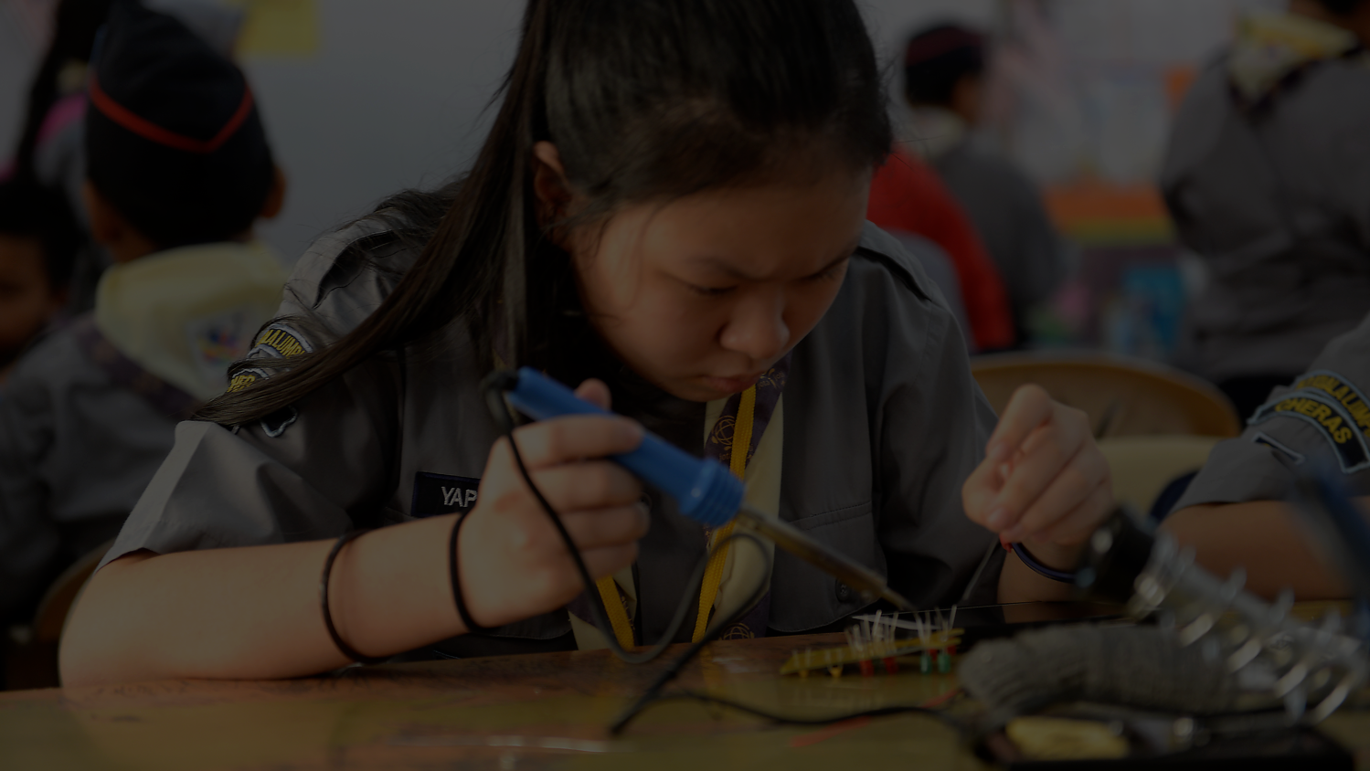
Areas and recommendations for implementation
Youth Programme
Adults in Scouting
Structures
Scouting events
Notes:
Read detailed suggestions in the World SfH policy.

Slide 10
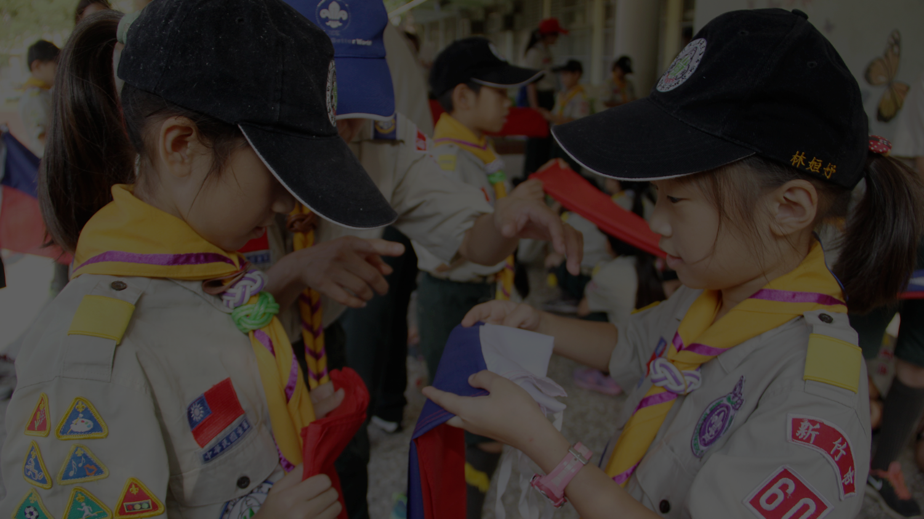
Some important questions to answer with
“YES”
Are you aware of the importance of the SfH?
Do you have any policy or other document related to the SfH adopted in your NSO?
Is the legal framework in the country considered, when addressing the area of youth protection in your NSO?

Slide 11

Lets try to be more specific …
Does the Youth programme delivery include measures related to the SfH?
Does the training of adults include knowledge related to the SfH?
Do you have procedures in place that describe how to properly react to report of harm?

Slide 12

If you respond with many ”NO”, exploration should be started by answering:
What is the cornerstone of the SfH implementation in the Youth Programme?
How can adults get knowledge about SfH?
How to properly receive, react and document any complain of harm or abuse?
How to organise SfH event?
And many more …

Slide 13
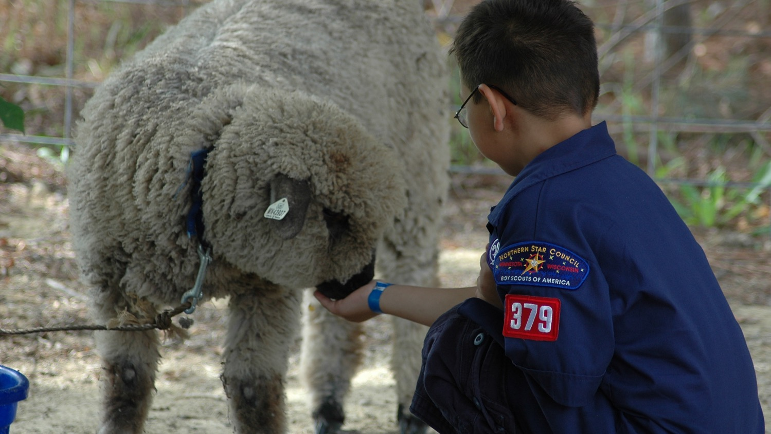
Safe from harm must become our every day reality!
Thank You
Notes:
https://www.scout.org/safe-from-harm-policy
Available in five WOSM Working languages

